Slide 2
Microsoft.Identity.Web
Innovation in the new normal: role of developers and communities
Rory Braybrook
Microsoft Identity Architect
Enterprise Mobility MVP
Twitter: @rbrayb
LinkedIn: https://www.linkedin.com/in/rory-braybrook-6050a521/
Blog: https://medium.com/the-new-control-plane

Slide 3
Microsoft Identity Platform

Slide 4
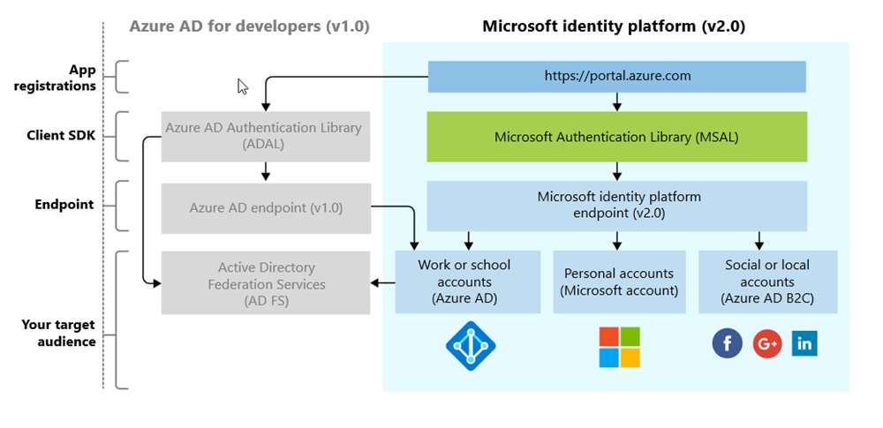
The Platform (not the Product!)

Slide 5
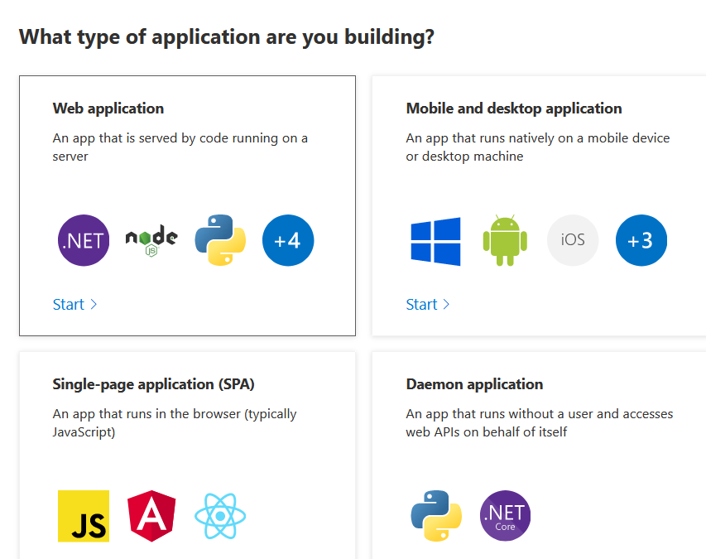
The Platform QuickStart's

Slide 6
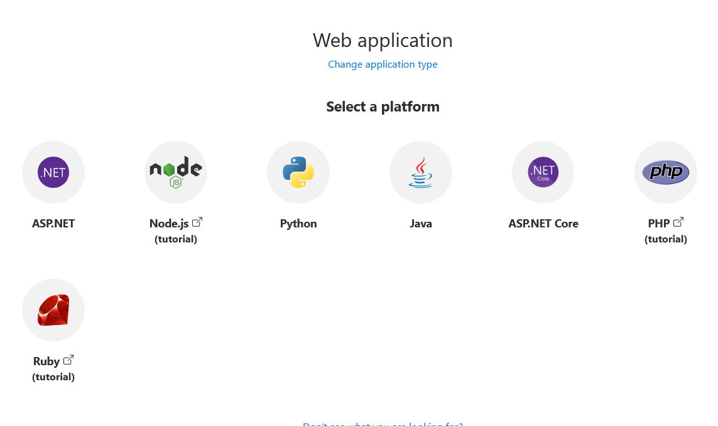
The Platform Application Type

Slide 7
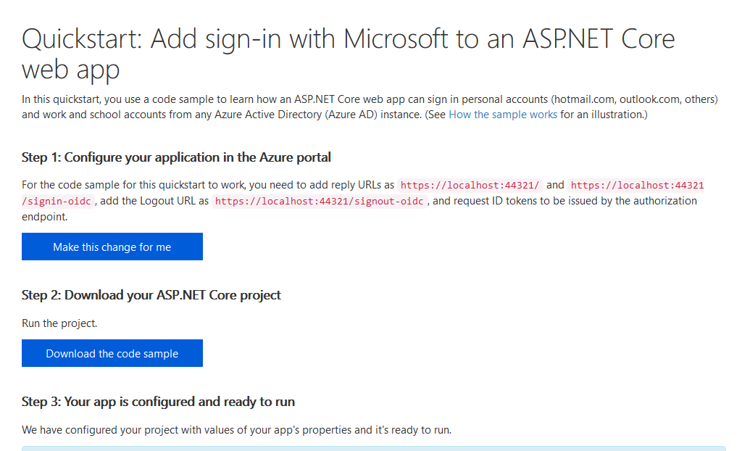
The Platform Detailed Tutorial

Slide 8
Microsoft Identity Web

Slide 9
Microsoft.Identity.Web
Microsoft Identity Web is a library which contains a set of reusable classes used in conjunction with ASP.NET Core for integrating with the Microsoft identity platform (formerly Azure AD v2.0 endpoint) and AAD B2C
This library is for specific usage with:
Web applications, which sign in users and, optionally, call web APIs
Protected web APIs, which optionally call protected downstream web APIs
Wiki: https://github.com/AzureAD/microsoft-identity-web/wiki

Slide 10
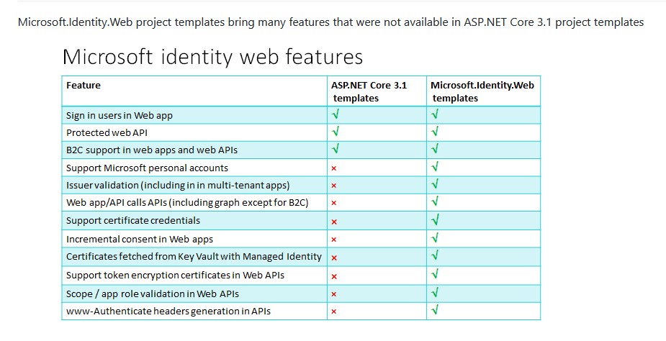
New Features

Slide 11
Templates
Command line : dotnet new --help
ASP.NET Core Empty web [C#], F# Web/Empty
ASP.NET Core Web App (Model-View-Controller, ... mvc2 [C#] Web/MVC
ASP.NET Core Web App (Model-View-Controller) mvc [C#], F# Web/MVC
ASP.NET Core Web App (Microsoft identity plat... webapp2 [C#] Web/MVC/Razor Pages
ASP.NET Core Web App webapp [C#] Web/MVC/Razor Pages
ASP.NET Core with Angular angular [C#] Web/MVC/SPA
ASP.NET Core with React.js react [C#] Web/MVC/SPA
ASP.NET Core with React.js and Redux reactredux [C#] Web/MVC/SPA
Razor Class Library razorclasslib [C#] Web/Razor/Library
ASP.NET Core Web API (Microsoft.Identity.Plat... webapi2 [C#] Web/WebAPI
ASP.NET Core Web API webapi [C#], F# Web/WebAPI

Slide 12
Authentication
Command line : dotnet new mvc2 --help
-au|--auth The type of authentication to use
None - No authentication
Individual - Individual authentication
IndividualB2C - Individual authentication with Azure AD B2C
SingleOrg - Organizational authentication for a single tenant
MultiOrg - Organizational authentication for multiple tenants
Windows - Windows authentication
Default: None

Slide 13
Create the project
Command line : dotnet new mvc2
--framework net5.0
--auth SingleOrg
--domain tenant.onmicrosoft.com
--client-id bb2…07e
--tenant-id 00d…c79
--callback-path /signin-oidc

Slide 14
Build the project
Command line : dotnet build

Slide 15
Run the project
Command line : dotnet run -f net5.0

Slide 16
Bottom code layout
Make your important points
Paste the code in the bottom section
Or paste from VS or VS Code using default light theme
main.js
async loadHeroes() {
this.message = 'getting the heroes, please be patient';
await this.getHeroesAction();
this.message = '';
},

Slide 17
One line of code
Startup.cs
using Microsoft.Identity.Web;
using Microsoft.Identity.Web.UI;
…
public void ConfigureServices(IServiceCollection services)
{
services.AddAuthentication(OpenIdConnectDefaults.AuthenticationScheme)
.AddMicrosoftIdentityWebApp(Configuration.GetSection("AzureAd"));

Slide 18
Demo

